Slide 1
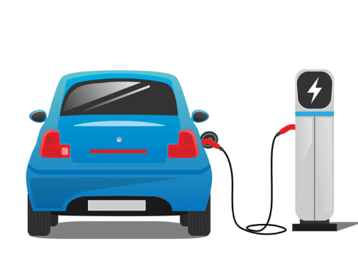
EV Charging

Slide 2
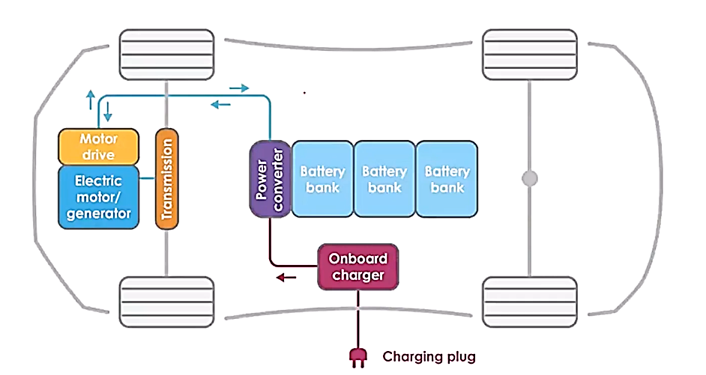
Components of Electric Vehicle

Slide 3
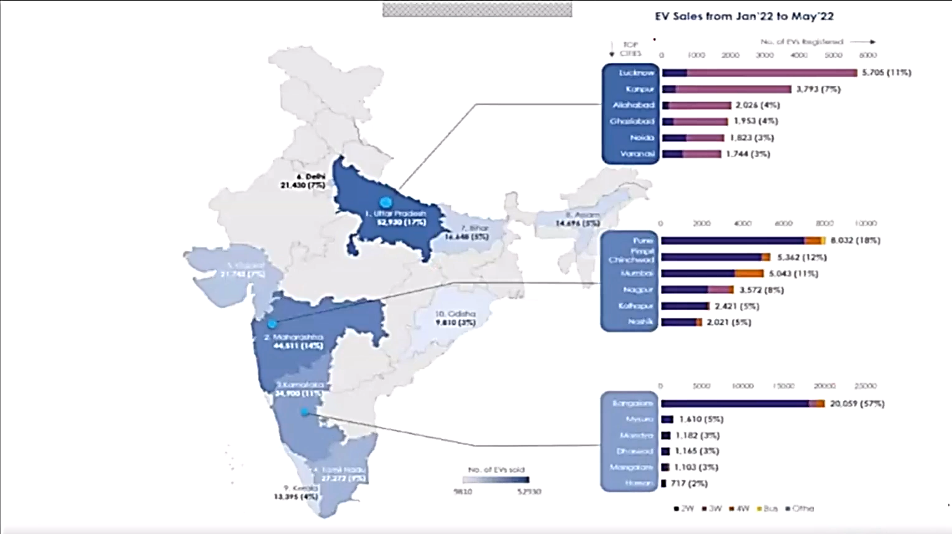

Slide 4
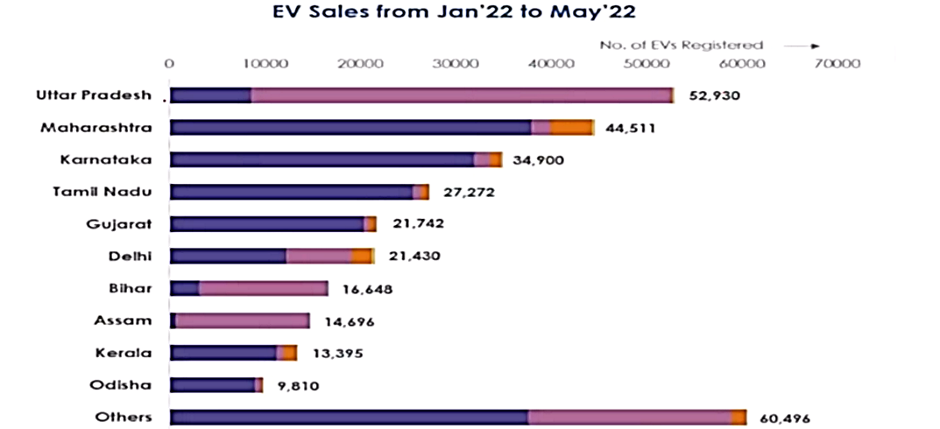
Category-wise EV Sales in Indian States From Jan’22 to May’22
A Safe, reliable, affordable and accessible charging infrastructure could be greatest enabler to EV adoption.

Slide 5
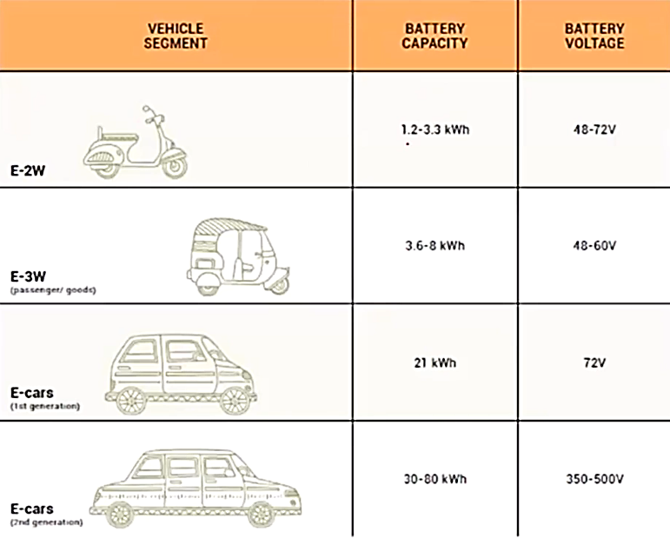

Slide 6
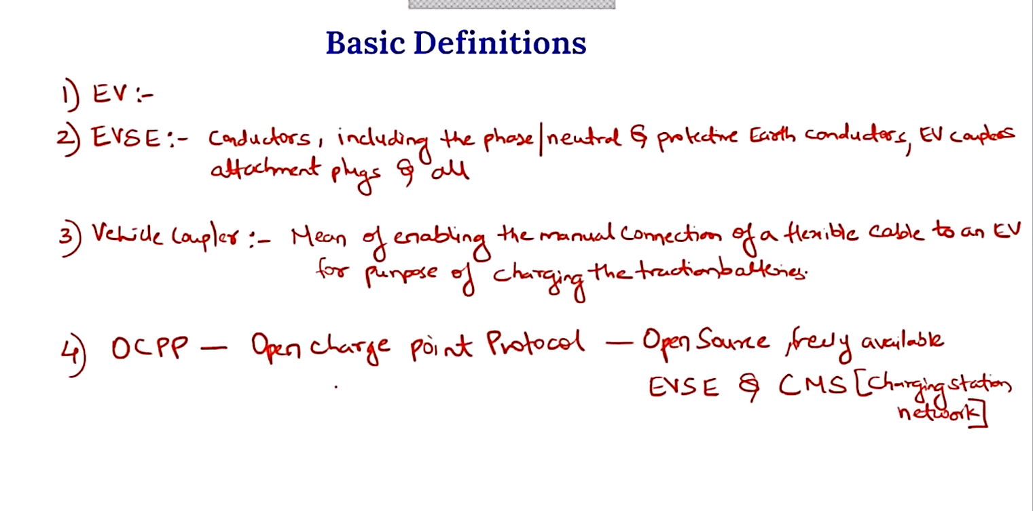

Slide 7
What is a EV Charger??
Used to charge Electric Vehicle
Power from Grid is given to Battery
Electric vehicles (EV) can be charged in a variety of ways, depending on location and requirement.
Specifications and standards for EV chargers, also known as
electric vehicle supply equipment (EVSE), vary from one country to another, based on available EV models in the market and the characteristics of the electricity grid.
In India grid is usually AC: Single, three phase
In India: single phase is 230V AC 15 Amp
In India: three phase is 415V AC 125 Amp

Slide 8
EV Charging Methods
1. Conductive Charging
2. Inductive Charging
3. Battery Swapping

Slide 9
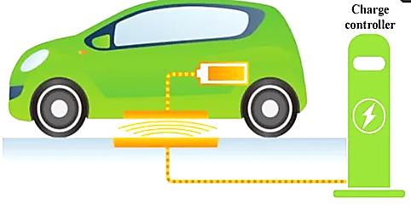
Conductive Charging

Slide 10
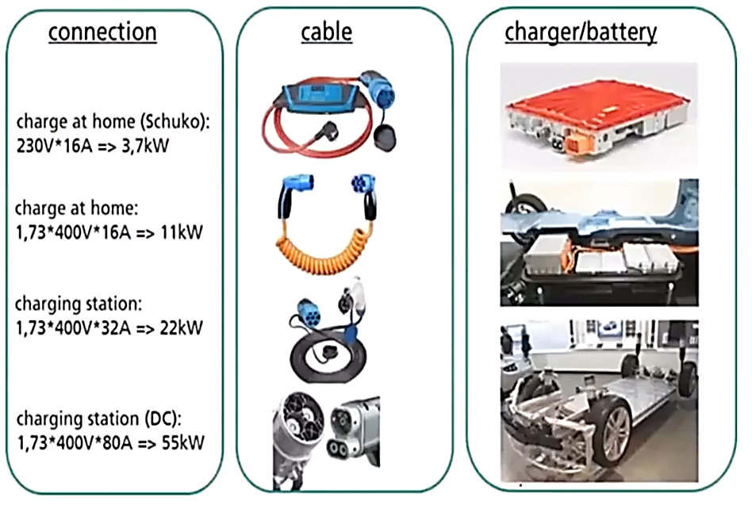
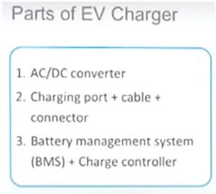

Slide 11
• Conductive power transfer uses a conductor to connect two electronic devices in order to transfer energy. There
are three basic components when it comes to charging an electric vehicle:
• The connection defines the performance and the duration of the charging process.
• For every type of connection there is a different type of plug.

Slide 12
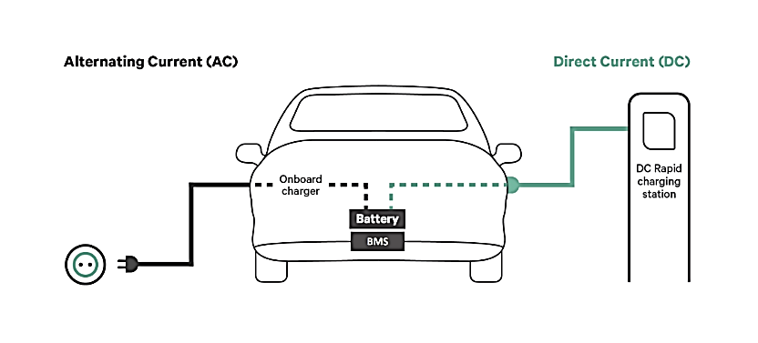
Types of EV Charging: Conductive

Slide 13
Home Charging: 6-8 hours charging time.
Each vehicle carries their own onboard
charging unit.
DC - quick charging station: 15-30
minutes charging time

Slide 14
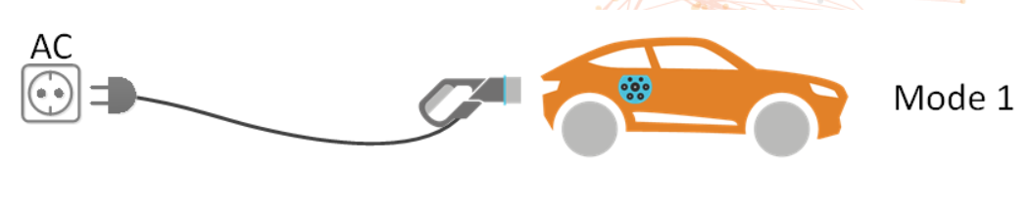
Ev Charging Modes
Mode:1
This mode entails slow AC charging via a regular electrical socket. This is no communication between the vehicle and the charging point. It is required to provide an earth wire to the EV and have an external means of protection against faults. In many countries, this form of charging is considered to be unsafe and is illegal.

Slide 15
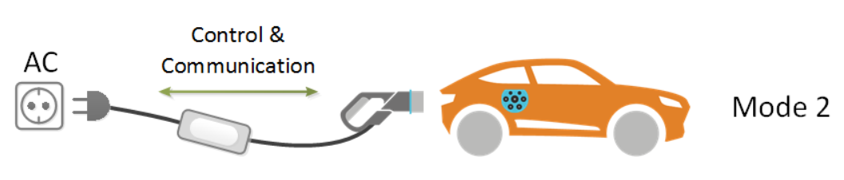
Mode 2
This mode provides for slow AC charging from a regular electricity socket. In addition, the charging cable is equipped with an In-Cable Control and Protection Device (IC-CPD), that is responsible for control, communication and protection (including residual current protection).

Slide 16
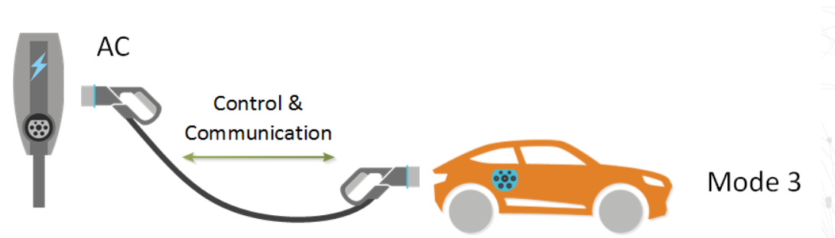
Mode 3
This mode entails both slow or semi-fast charging via a dedicated electrical socket for EV charging. The charger (or the charging station) has an EV specific socket, generally corresponding to Type 1 or Type 2. A charging cable with an EV plug on both sides is used to connect the EV to the charger. The charging station is responsible for the control, communication and protection of the charging process (including residual current protection). This mode is commonly used for public charging stations and can facilitate integration with smart grids.

Slide 17
EVSE Power Ratings
 | Power | Current types | Compatible EV Segments
Normal power charging | P < 7KW | AC & DC | E – 2Ws, e-3Ws, e-cars, others LCVs (up to 1 ton)
 | 7KW < p < 22KW | AC & DC
High power Charging | 22KW < p < 50KW | DC | E- cars, LCVs and MCVs (1-6 tons)
 | 50KW < p < 200KW | DC

Slide 18
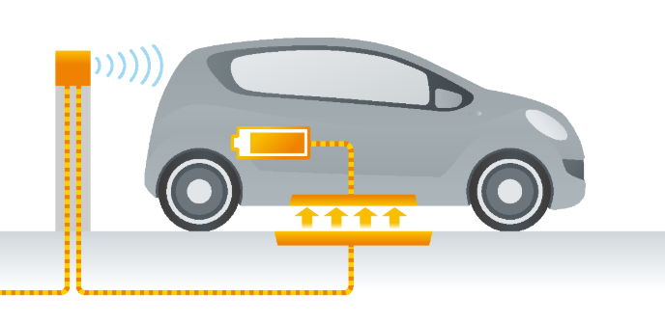
Inductive Charging

Slide 19
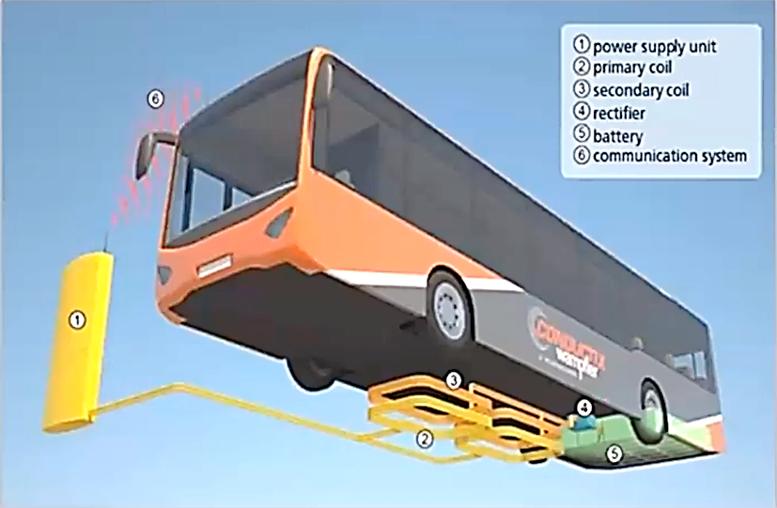
Types of EV Charging: Inductive
The power supply unit supplies the primary coil with energy.
The electric current in the primary coil creates electro-magnetic alternating field.
The electromagnetic alternating field allows for the transmission of energy from the primary to the secondary coil to charge the battery of the electric vehicle without the two components coming into contact with each other.

Slide 20
EV Charging Methods
1. Conductive Charging
2. Inductive Charging
3. Battery Swapping

Slide 21
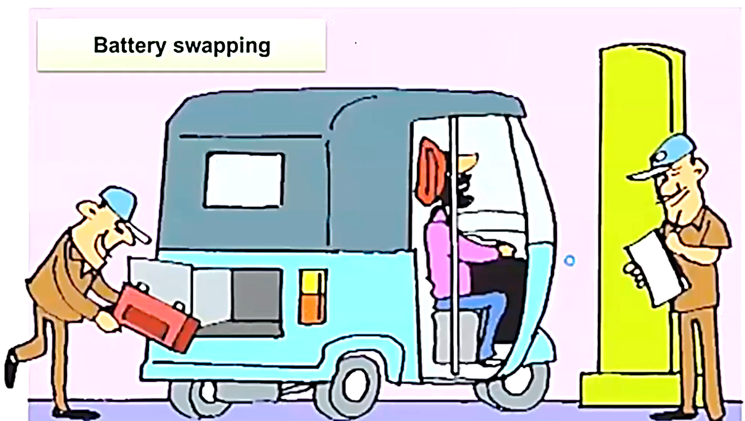

Slide 22
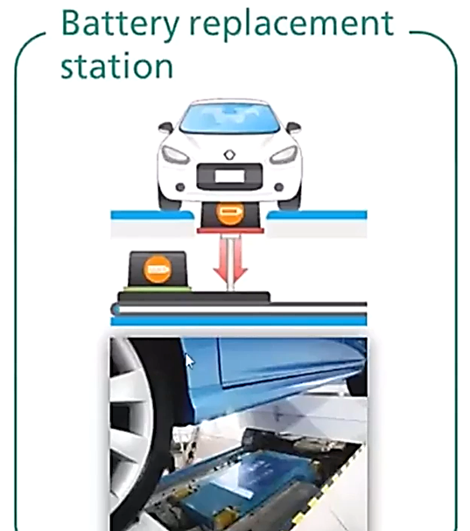
Types of EV Charging: Battery Swap
Aside from quick charging via direct current (DC), battery replacement is the only other option to overcome the range
limits of electric vehicles at the moment.
This is how it works:
If an electric vehicle is running out of energy, the driver can drive into a battery replacement station.
In the station the empty battery is replaced by a full battery automatically.
Some EVs are specifically designed with a battery interface that is compatible with this charging.

Slide 23
Advantages and challenges battery swapping
Advantages | Barriers
EV. recharging is completed in minutes | Lack of standardization among Ev batteries
Batteries can be charged away from swapping point. allowing more freedom in setting up swap facilities | Unsuitable battery pack design to enable ease of swapping (weight. dimensions and ergonomics)
Reduction in upfront cost Of EV. as battery ownership is replaced by battery leasing | Greater number of batteries needed to power number Of EVs
Increased predictability of battery life due to controlled charging conditions | Shorter commercial life of battery packs due to customer preference for new batteries With higher range
 | Slow adoption of charging method by OEMs
 | Higher costs of battery leasing over the life Of the EV
 | Higher GST on separate battery (18%) vs battery sold With EV (5%)

Slide 24
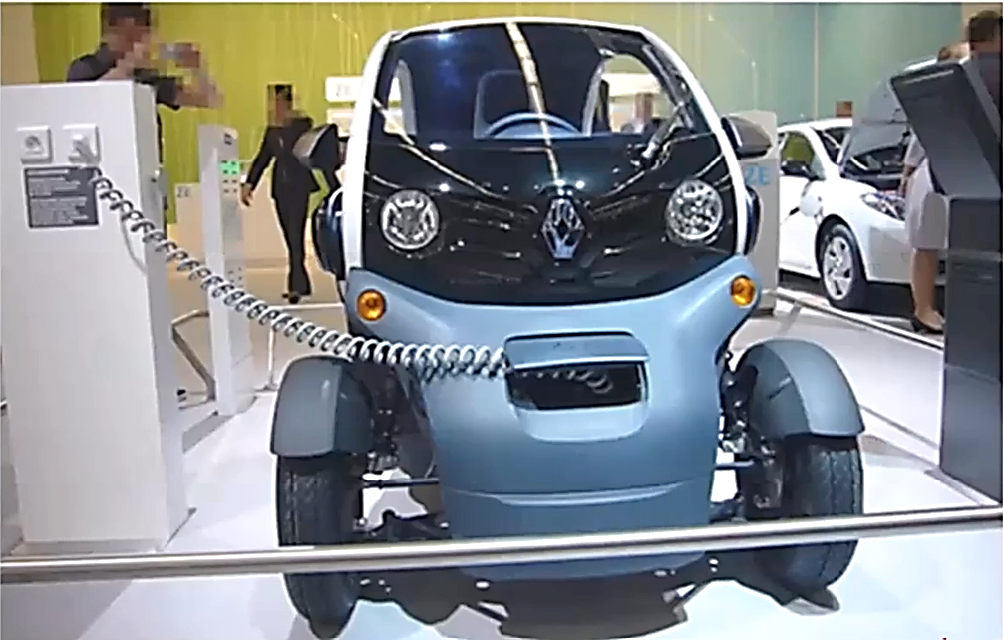

Slide 25
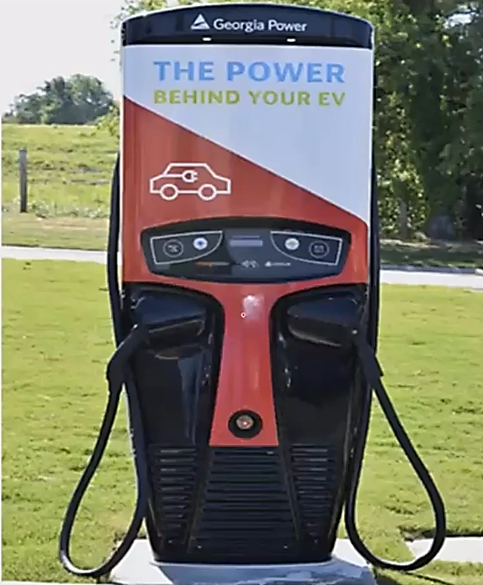

Slide 26
EV Charging Standards for interoperability
Indian Standards for AC Charging
IS-17017
IS-17017-Part 1
IS-17017-Part 2
Indian Standards for DC charging
• IS-17017-Part-23
• IS-17017-Part-24
• IS-17017-Part25
INDIAN STANDARDS FOR BATTERY SWAPPING

Slide 27
EV Charging Infrastructure
Private
Semi Public
Public

Slide 28
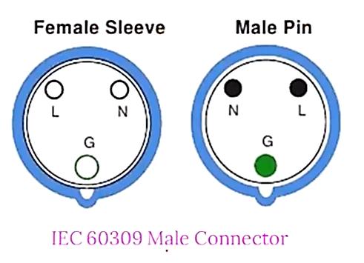
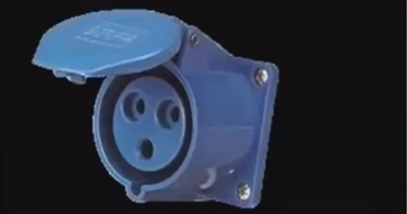

Connectors for Ac Slow Charging and AC fast Charging
IEC 60309 Female Connector

Slide 29
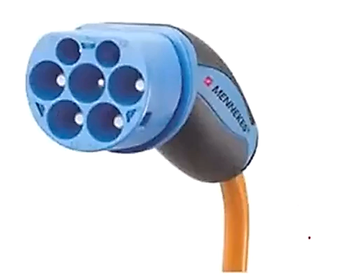

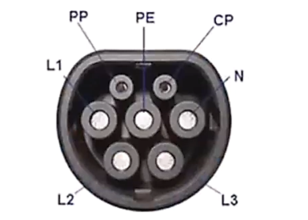
IEC 62196-type 2 Female Connector
IEC 62196-type 2 Male Connector

Slide 30
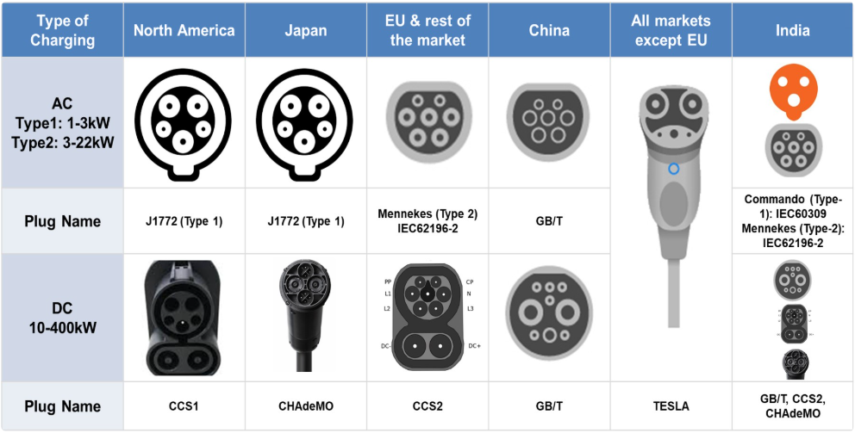

Slide 31
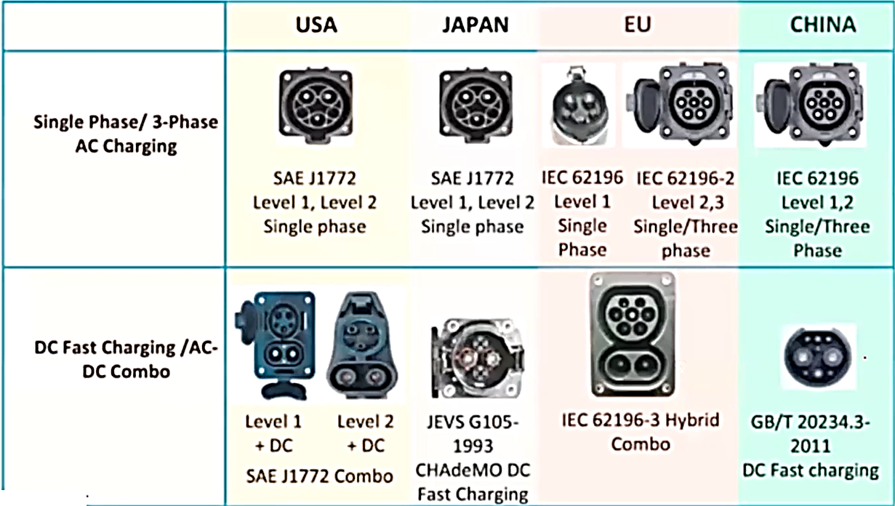

Slide 32
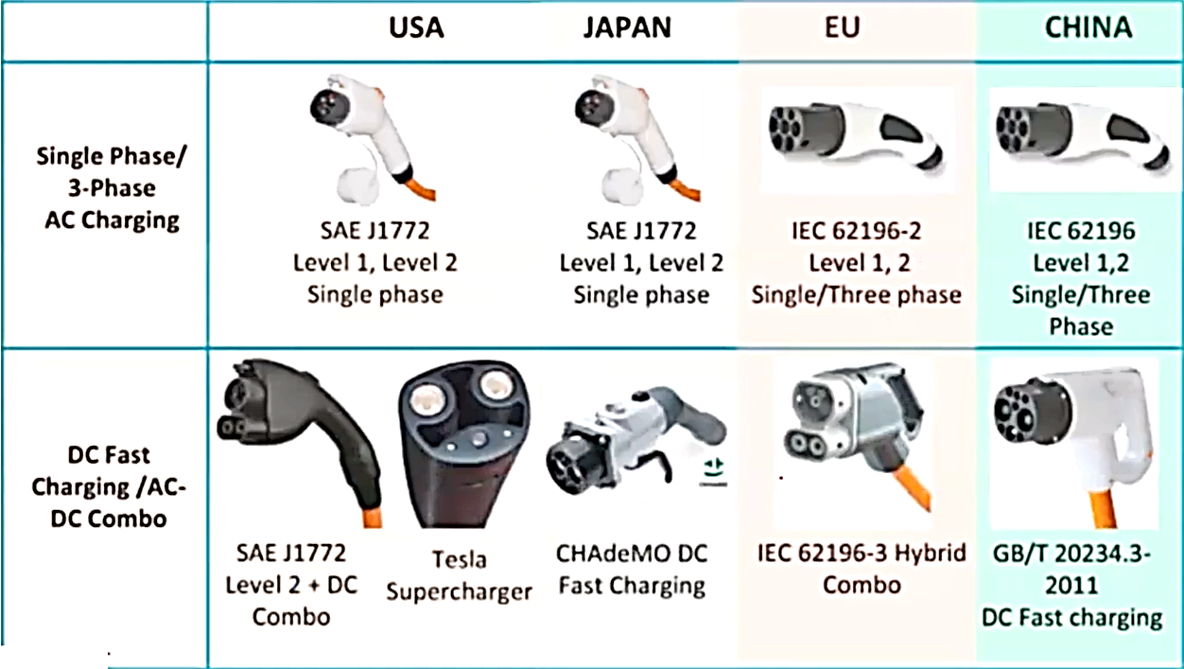

Slide 33
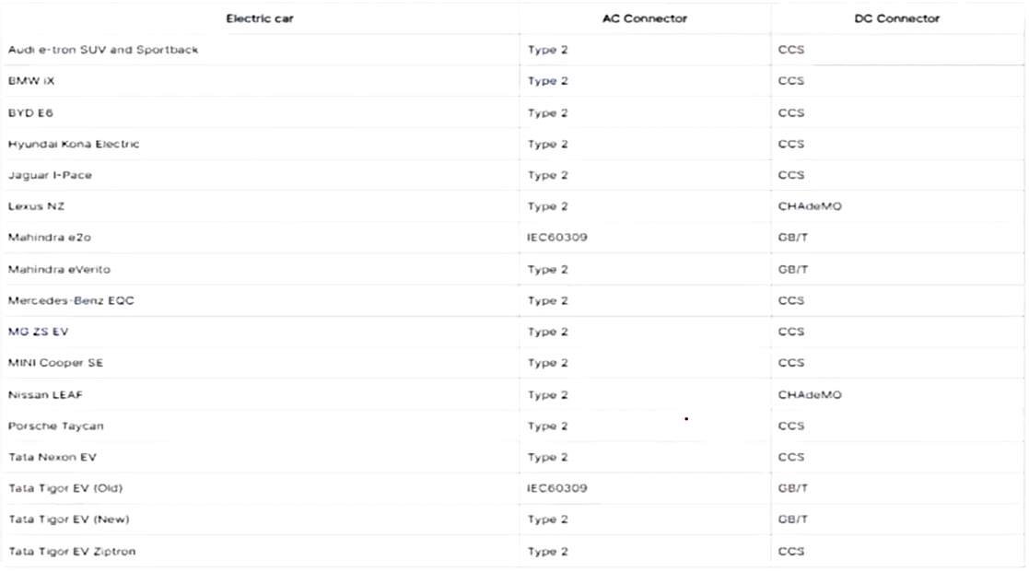
Indian Electric Cars & the types of connectors:

Slide 34
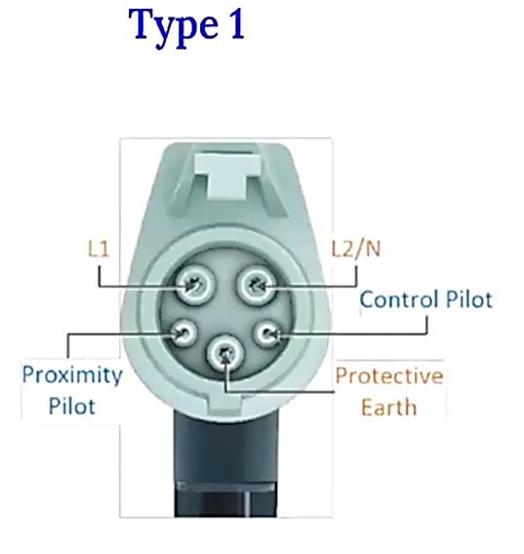
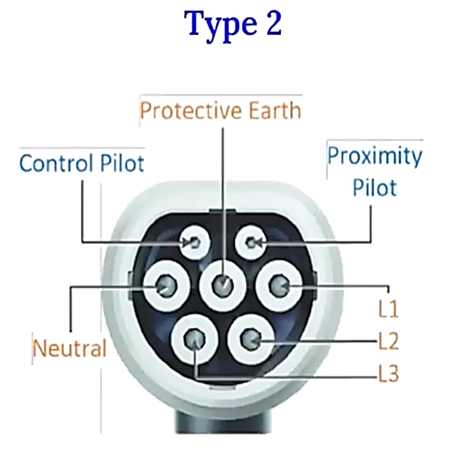

Slide 35
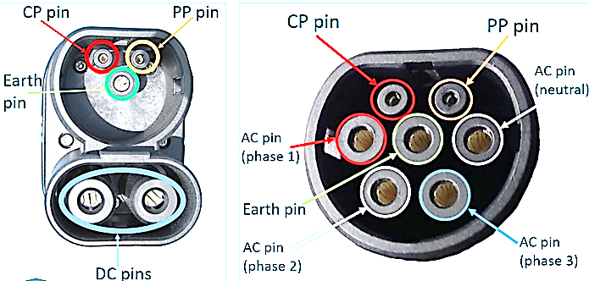

Slide 36
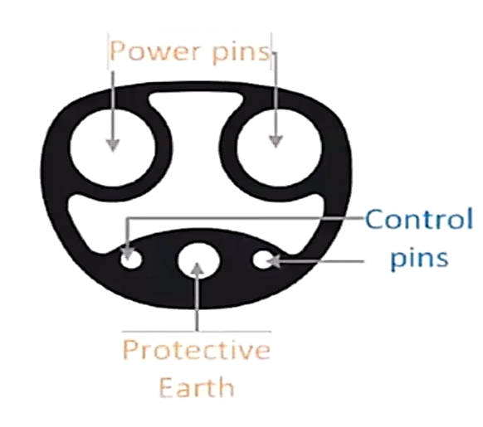
Tesla US Connector:

Slide 37
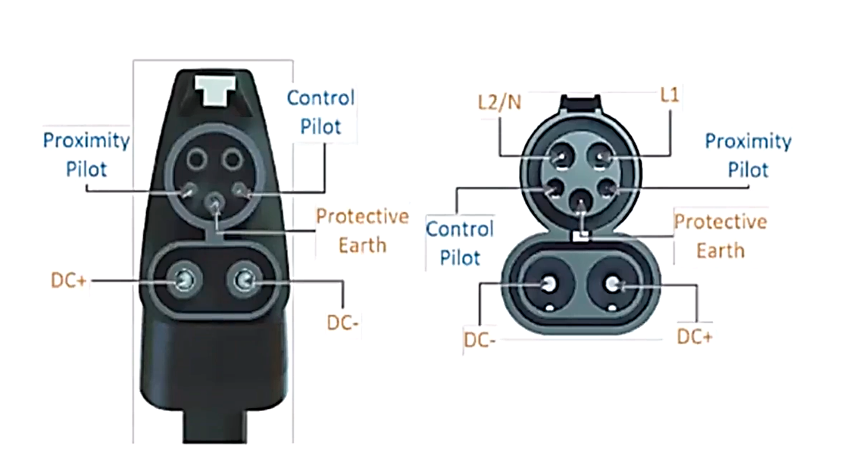
CCS/Combo 1

Slide 38
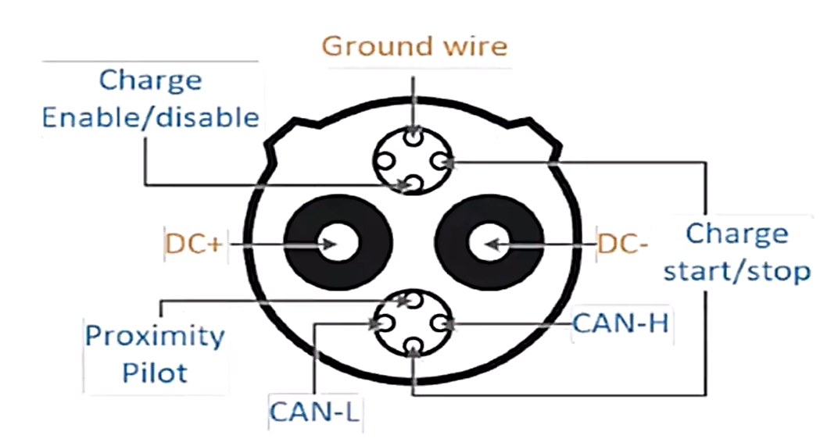
Chademo

Slide 39
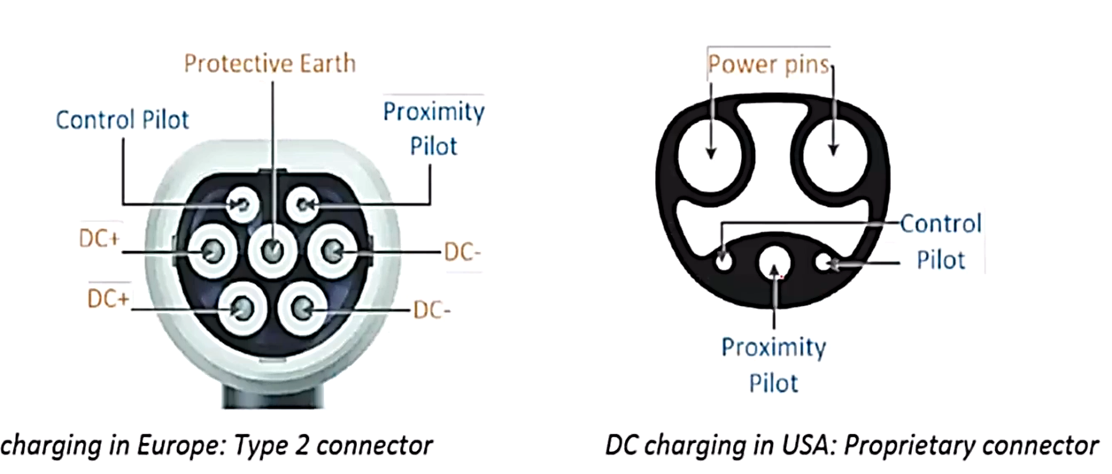
Tesla Dc Chargers

Slide 40
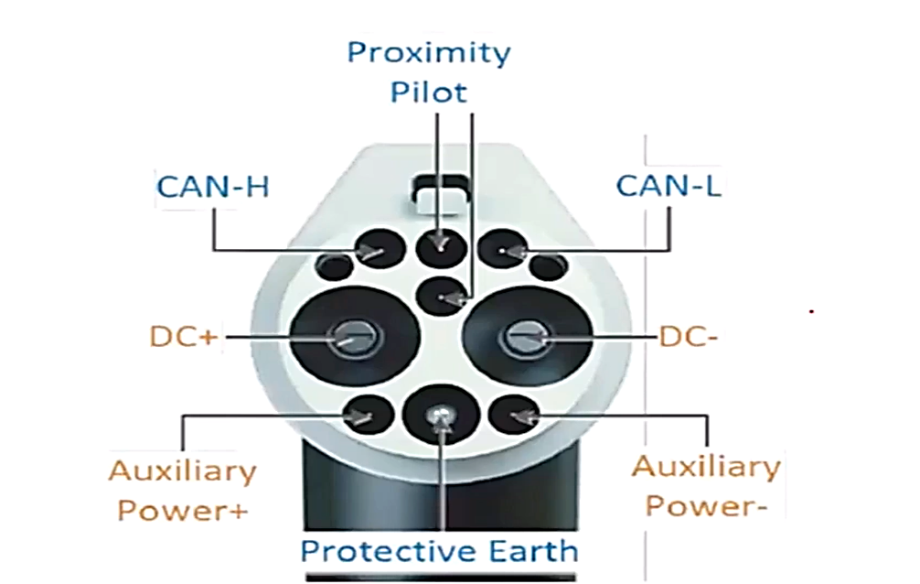
China GB / T

Slide 41
List of EV Charging standards
IEC 62196-1/IEC 62196-2/IEC 62196-3
IEC61851-1/-21/-22/-23/-24
ISO/IEC 15118-1/-2/-3:ISO/IEC 15118
Chinese GB/ T 20234.1/.2/.3
IS17017/IS17017-PART-1/IS17017-PART-2

Slide 42
List of EV Charging standards
IEC 62196-1/IEC 62196-2/IEC 62196-3
IEC61851-1/-21/-22/-23/-24
ISO/IEC 15118-1/-2/-3:ISO/IEC 15118
Chinese GB/ T 20234.1/.2/.3
IS17017/IS17017-PART-1/IS17017-PART-2

Slide 43
Calculating the AC charging Power

Slide 44
Q.1) How much of AC Current is required for single phase AC Charging When Charging at a power of 7.36 KW?

Slide 45
Q.2) An EV Consumes 120 Wh/Km And is required to go on a 250 km trip. What Must be the
AC current drawn from a single phase 230V AC Charger so that the car can be fully charged in 5h from an empty battery?

Slide 46
Q.3) A Tata Nexon EV owner driving 100km every day in India wants to charge his EV for 2 hours in the evening using his AC power connection at home. The
car consumes 170 Wh/km.
What must be the minimum AC current rating for single phase and three phase AC charging that he must install at his house if he decides to charge overnight in 8 hours?
Answer Option:
1) 230V 32A,400V 32A
2) 230V 63A,400V 16A
3) 230V 63A,400V 32A

Slide 47
EV Infrastructure
Charging
Battery Swap
On-board
Charging
Off-board
Charging
Commercial vehicle
Passenger car
Ac Charging spot
Dc charger
Side – swapping
Real swapping
Bottom-swapping
Private car
Private car
Public bus
Public bus
Sanitation vehicle
Private car taxi

